Slide 1
Cracking Wireless Networks
Paul Varoutsos

Slide 2
DISCLAIMER
This presentation is for informational purposes only.
Attempting to access a network other than your own, or one you have permission to manipulate is illegal in some U.S. jurisdictions. Paul Varoutsos, is not to be held liable for any damages or illegal/unethical activity resulting from the use or misuse of the information in this presentation.

Slide 3
Contents
Types of Networks
WEP
WPA
About WPA
How This Crack Works
An Introduction to Aircrack
Demonstration of a WPA crack

Slide 4
About WPA
Bssid
Essid
Channel
Authentication and cipher types

Slide 5



How This Crack Works
Access Point
Connected Computer
Problem?
Packets
Packets
Us
Overwhelm client with packets….

Slide 6
How This Crack Works
Create a quick denial of service attack (DoS)
Capture a four-way handshake
A client MUST be connected to the access point
Apply a brute force dictionary attack to the handshake.
The dictionary MUST contain the password

Slide 7
So What Do I Need to Start Messing With My Neighbors?
Knowledge of Unix (Represent!)
aircack-ng software suite
A Wi-Fi card that supports monitor mode
Can be tricky.
A large dictionary
Lots of Processing Power
Cracking my neighbors wi-fi took 8 hours

Slide 8
Aircrack-ng: Overview
Commands
airmon-ng - A Bash script that turns your network card to monitor mode
airodump-ng – A wireless packet capture tool
aireplay-ng – Inject packets into a wireless network to generate traffic
If all else fails, you can use this disconnect people from any wireless network at will
airolib-ng – Manage and create WPA hash tables
aircrack-ng – a 802.11 WEP/WPA key cracker

Slide 9
airodump-ng
A wireless packet sniffing tool
airodump-ng mon0
Basic command
mon0 is the network interface name
airodump-ng --bssid 00:1B:9E:B2:60:00 -c 1 -w output mon0
--bssid - Only show the network with the given BSSID
-c Only listen on channel 1
-w Output captured data to ./output

Slide 10
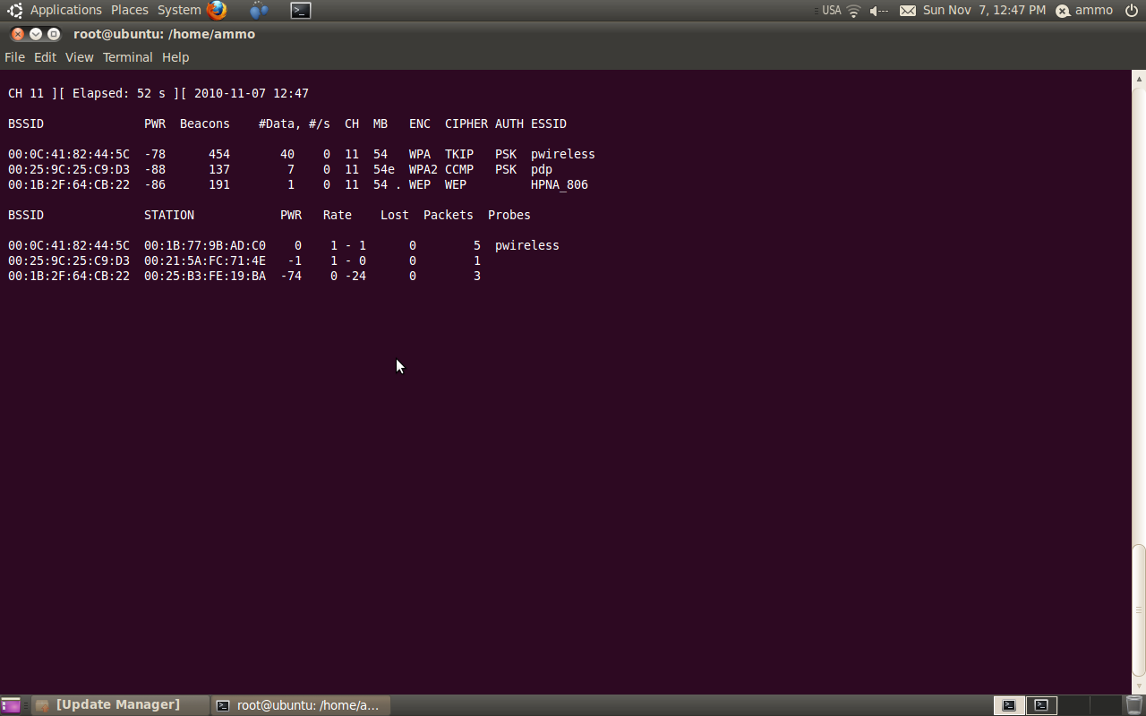
Example
MAC address of the access point

Slide 11
Example
Signal level as reported by the network card.
Can be used to pinpoint the physical location of an access point!

Slide 12
Example
Number of beacons the access point sends out.

Slide 13
Example
Number of captured packets.

Slide 14
Example
Packets per second (over last 10 seconds)

Slide 15
Example
Max speed that the access point supports

Slide 16
Example
Encryption type
WEP = LOL

Slide 17
Example
Cipher type used

Slide 18
Example
Authentication protocol used

Slide 19
Example
The SSID of the access point. May be empty if the SSID is hidden.
(But airodump-ng can figure it out anyway)

Slide 20
Example
MAC address of each client looking for an access point. If not connected to an access point yet, BSSID is blank.

Slide 21
Example
Data rate between client and access point

Slide 22
Example
# of lost packets

Slide 23
Example
# of packets sent by client

Slide 24
Example
ESSIDs probed by the client. The network that the client if trying to connect to (if not already connected)

Slide 25
aireplay-ng
Inject packets into a wireless network
Used to generate traffic for crackin WPA and WEP
aireplay-ng --deauth 10 -a 00:1B:9E:B2:60:00 -c 00:12:17:94:90:0D mon0
-a Set the acces point MAC address
-c Set the destination MAC address
--dauth sends deauthentication packets
Recovers a hidden ESSID
Forces a client to authenticate

Slide 26
airolib-ng
Basically just a large SQLite database
Manage and create WPA/WPA2 pre-computed hash tables
Stores ESSIDs and Passwords to create hashes
Hashes are used to brute force the password
airolib-ng crackwpa --import essid ~/essid
airolib-ng crackwpa --import passwd ~/passwd

Slide 27
aircrack-ng
802.11 WEP/WPA key cracker
Easily cracks WEP after enough packets are captured
http://eprint.iacr.org/2007/120.pdf
For WPA a dictionary method is used

Slide 28
WPA Crack Demo…

